Slide 1

CAP444 OBJECT ORIENTED PROGRAMMING USING C++

Slide 2
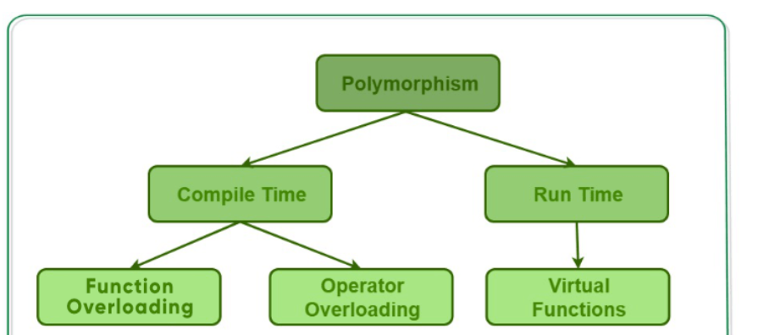
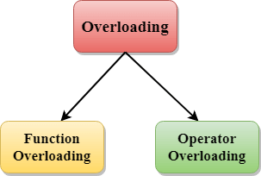
Polymorphism

Slide 3
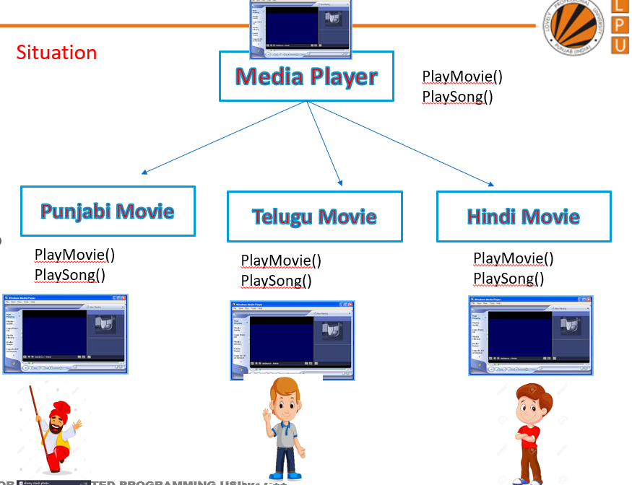
Virtual Function
A virtual function is a member function in the base class that we expect to redefine in derived classes.

Slide 4
A virtual function is a member function which is declared within a base class and is re-defined (overridden) by a derived class.
When you refer to a derived class object using a pointer or a reference to the base class, you can call a virtual function for that object and execute the derived class’s version of the function.
They are mainly used to achieve Runtime polymorphism
Functions are declared with a virtual keyword in base class.
The resolving of function call is done at runtime.

Slide 5
Rules for Virtual Functions
Virtual functions cannot be static.
A virtual function can be a friend function of another class.
Virtual functions should be accessed using pointer or reference of base class type to achieve runtime polymorphism.
The prototype of virtual functions should be the same in the base as well as derived class.
They are always defined in the base class and overridden in a derived class. It is not mandatory for the derived class to override (or re-define the virtual function), in that case, the base class version of the function is used.
A class may have virtual destructor but it cannot have a virtual constructor.

Slide 6
#include<iostream>
using namespace std;
class base {
public:
virtual void print()
{
cout << "print base class\n";
}
void show()
{
cout << "show base class\n";
}
};
class derived : public base {
public:
void print()
{
cout << "print derived class\n";
}
void show()
{
cout << "show derived class\n";
}
};
int main()
{
base *bptr;
derived d;
bptr = &d;
// Non-virtual function, binded at compile time
bptr->print();
// Non-virtual function, binded at compile time
bptr->show();
return 0;
}
Output
Print base class
Show base class

Slide 7
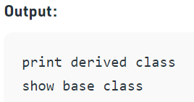
#include<iostream>
using namespace std;
class base {
public:
virtual void print()
{
cout << "print base class\n";
}
void show()
{
cout << "show base class\n";
}
};
class derived : public base {
public:
void print()
{
cout << "print derived class\n";
}
void show()
{
cout << "show derived class\n";
}
};
int main()
{
base *bptr;
derived d;
bptr = &d;
// Virtual function, binded at runtime
bptr->print();
// Non-virtual function, binded at compile time
bptr->show();
return 0;
}

Slide 8
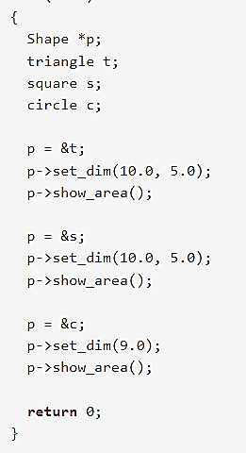
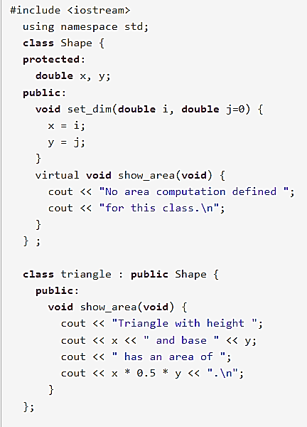
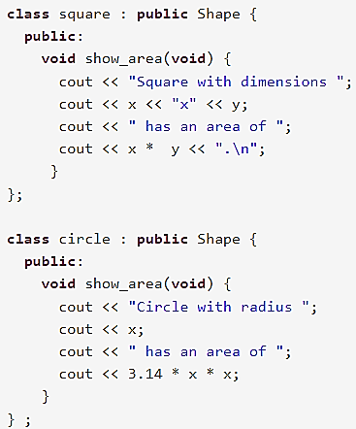

Slide 9
Runtime polymorphism is achieved only through a pointer (or reference) of base class type.
Also, a base class pointer can point to the objects of base class as well as to the objects of derived class.

Slide 10
Pure Virtual Function
A virtual function is not used for performing any task. It only serves as a placeholder.
When the function has no definition, such function is known as "do-nothing" function.
The "do-nothing" function is known as a pure virtual function. A pure virtual function is a function declared in the base class that has no definition relative to the base class.
A class containing the pure virtual function cannot be used to declare the objects of its own, such classes are known as abstract base classes.
The main objective of the base class is to provide the traits to the derived classes and to create the base pointer used for achieving the runtime polymorphism.

Slide 11
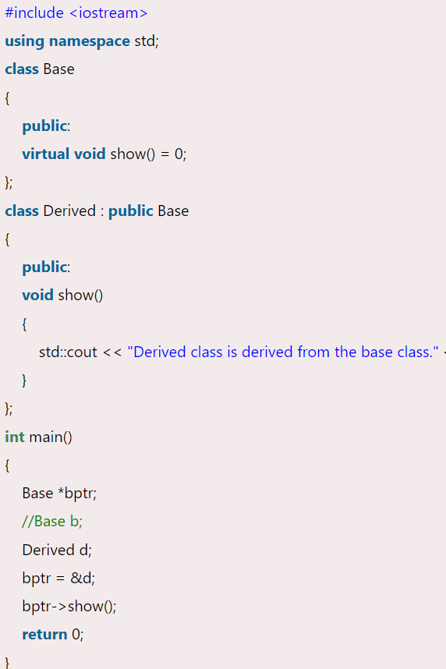

Slide 12
Abstract Class
Sometimes implementation of function is not required in a base class such a class is called abstract class.
In such cases we have to make function as abstract function by using virtual keyword that is also called pure virtual function.
A pure virtual function is declared by assigning 0 in declaration.
Example

Slide 13





Situation
Transportation:
Vehicle_Registration()
Himachal_Transport
Vehicle_Registration()
Karnataka_Transport
Vehicle_Registration()
Bihar_Transport
Vehicle_Registration()
Punjab_Transport
Vehicle_Registration()
PB081234
HP014567
KA023333
BR012345

Slide 14

Area
getArea()
getArea()
getArea()
Area = w × h w = width h = height
Area = π × r²

Slide 15
Important points:
A class is abstract if it has at least one pure virtual function.
If we do not override the pure virtual function in derived class, then derived class also becomes abstract class.
An abstract class can have constructors.
We cannot create objects of abstract classes.

Slide 16
Pinter to an Object
A pointer to an object acts the same as Pointer to a variable. But here, in place of the address of the variable, address of the object is stored. In the main function, when an object is created to a class, a pointer variable is declared in the same manner as we declared for the variable, and it will store the object's address.
For creating a pointer to an object, we should not use data type for the Pointer. Instead, we need to use the class name for the object pointer.
If we want to use a member function in the class using the Pointer in the main function, then we need to use the -> symbol, as shown in the below example.

Slide 17

class Rectangle
{
private:
int length;
int breadth;
public:
Rectangle(int l, int b)
{
length=l;
breadth=b;
}
int getArea()
{
return 2*length*breadth;
}
};
int main()
{
// creating an object of Rectangle
Rectangle var1(10,30);
//creating a pointer for the object using class name as data type
Rectangle* ptr = &var1;
//calling the member function using -> symbol
int area = ptr->getArea();
cout<<"Area of rectangle is: "<<area;
return 0;
}

Slide 18
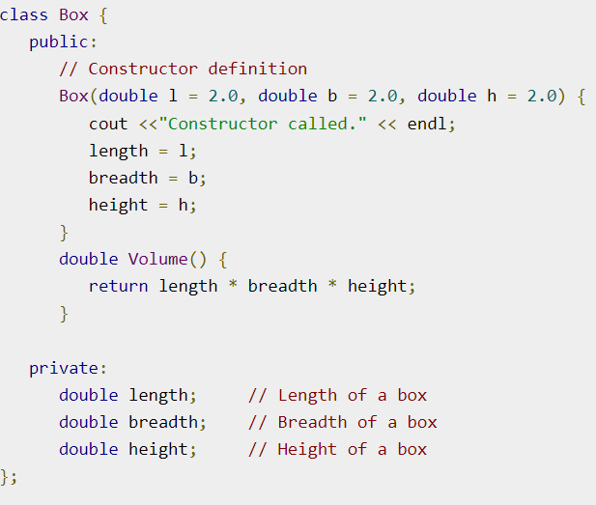
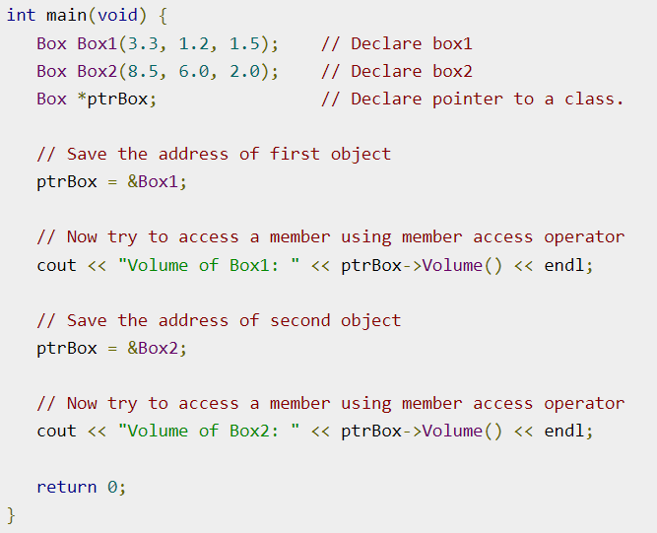
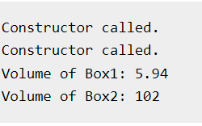

Slide 19
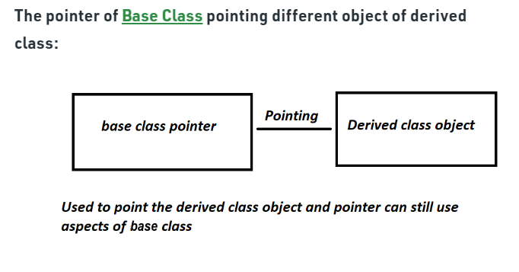
Pointer to derived class

Slide 20
Pointer to derived class
class base{};
class derive: public base{};
base b1,*b2;
derive d1;
b2=&d1;

Slide 21
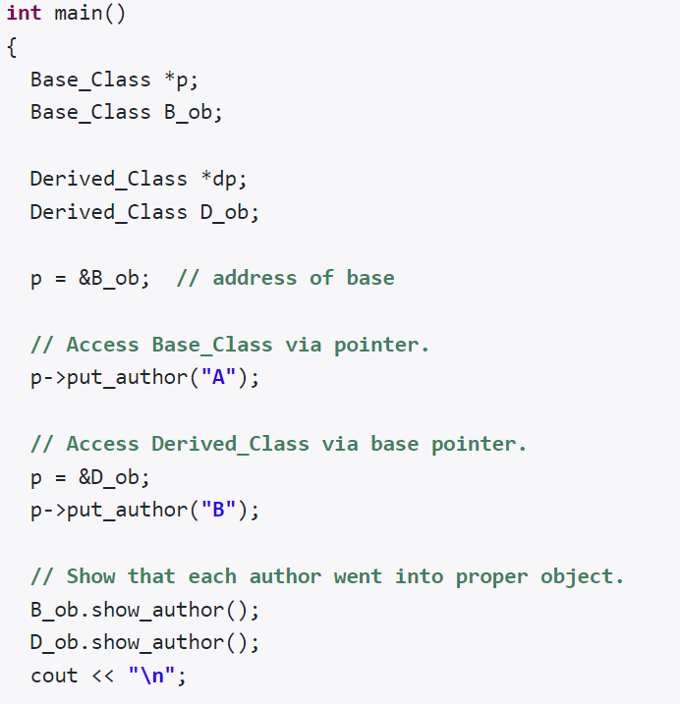
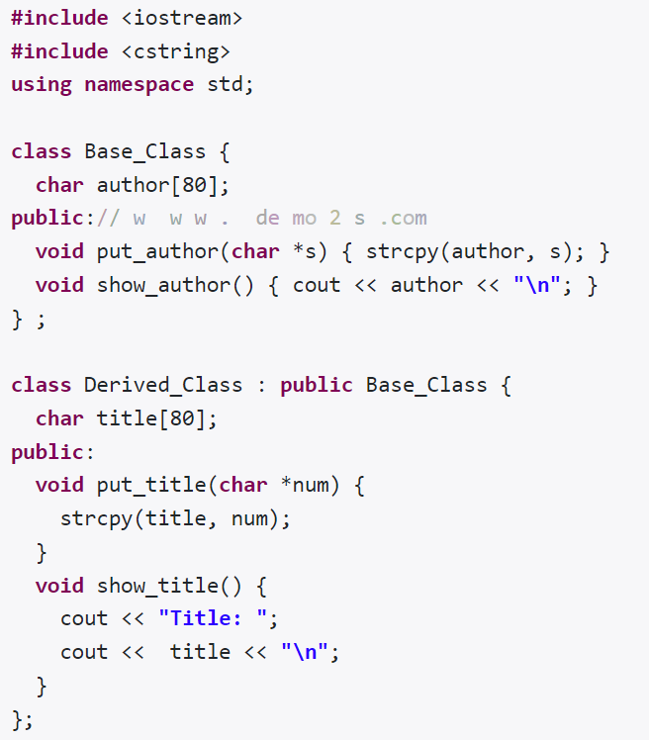
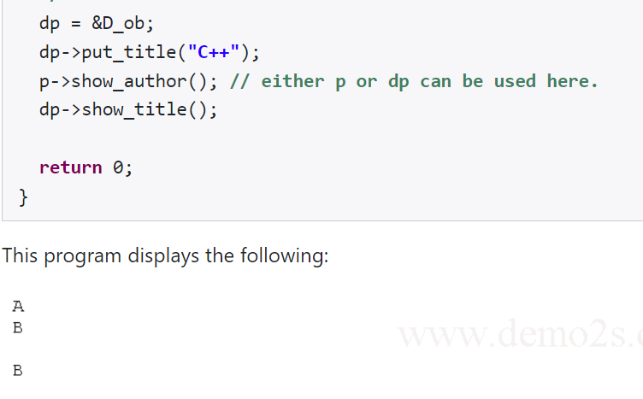

Slide 22
This pointer
'this' is a pointer that points to the object for which this function was called. The 'this' pointer holds the memory address of the current object. The 'this' pointer is implicitly passed to a member function when it is called.
Every object in C++ has access to its own address through an important pointer called this pointer. The this pointer is an implicit parameter to all member functions. Therefore, inside a member function, this may be used to refer to the invoking object.
Friend functions do not have a this pointer, because friends are not members of a class. Only member functions have a this pointer.

Slide 23
